Slide 1


LITTLE RED RIDING HOOD

Slide 2

LITTLE RED RIDING HOOD

Slide 3

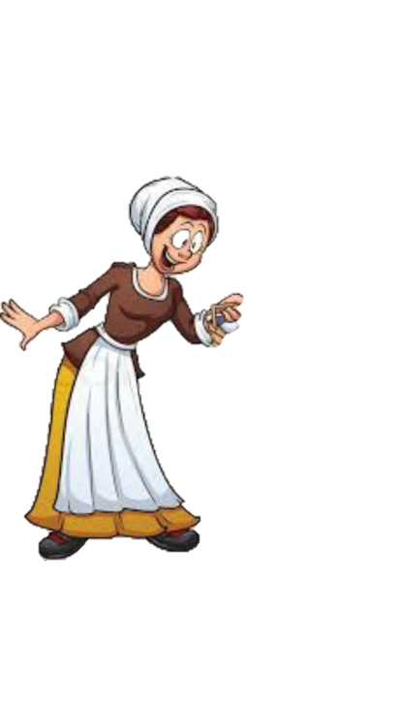
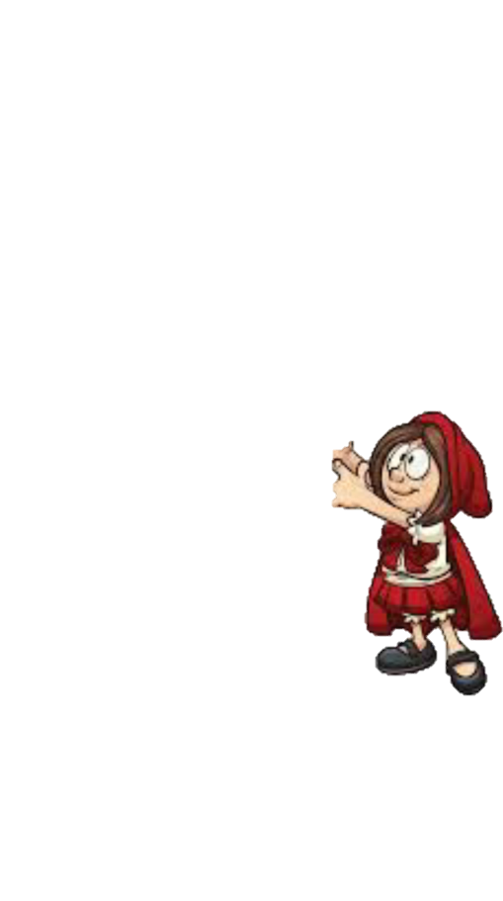

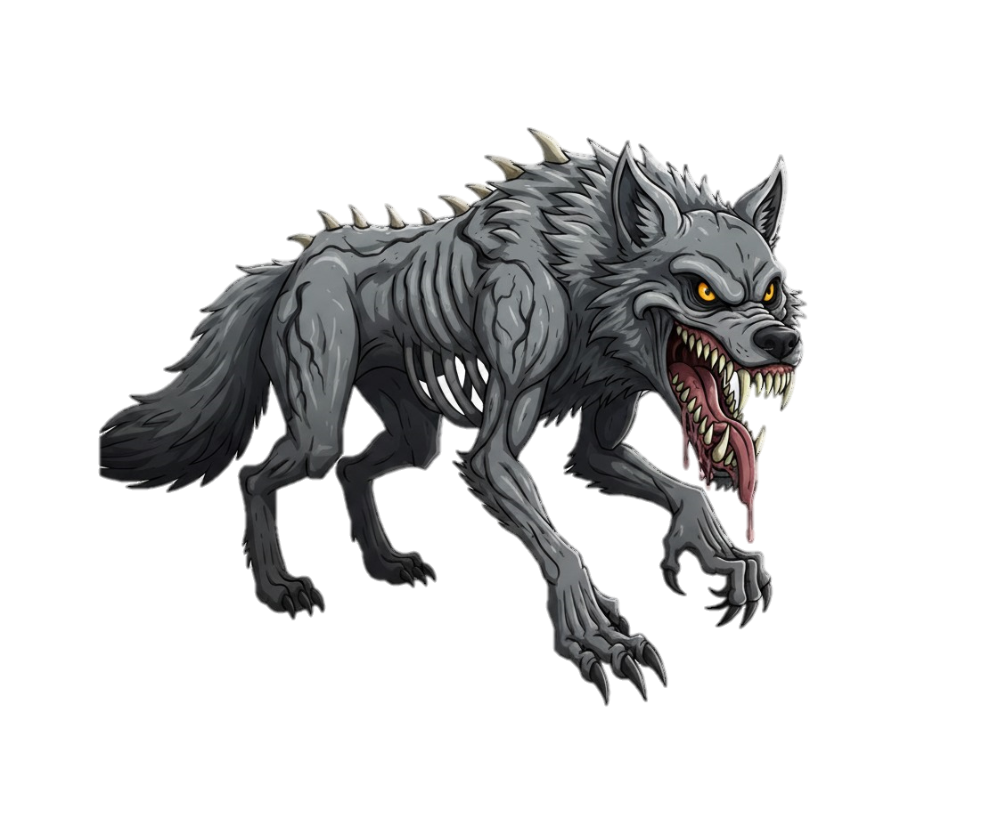
LITTLE RED RIDING HOOD

Slide 4
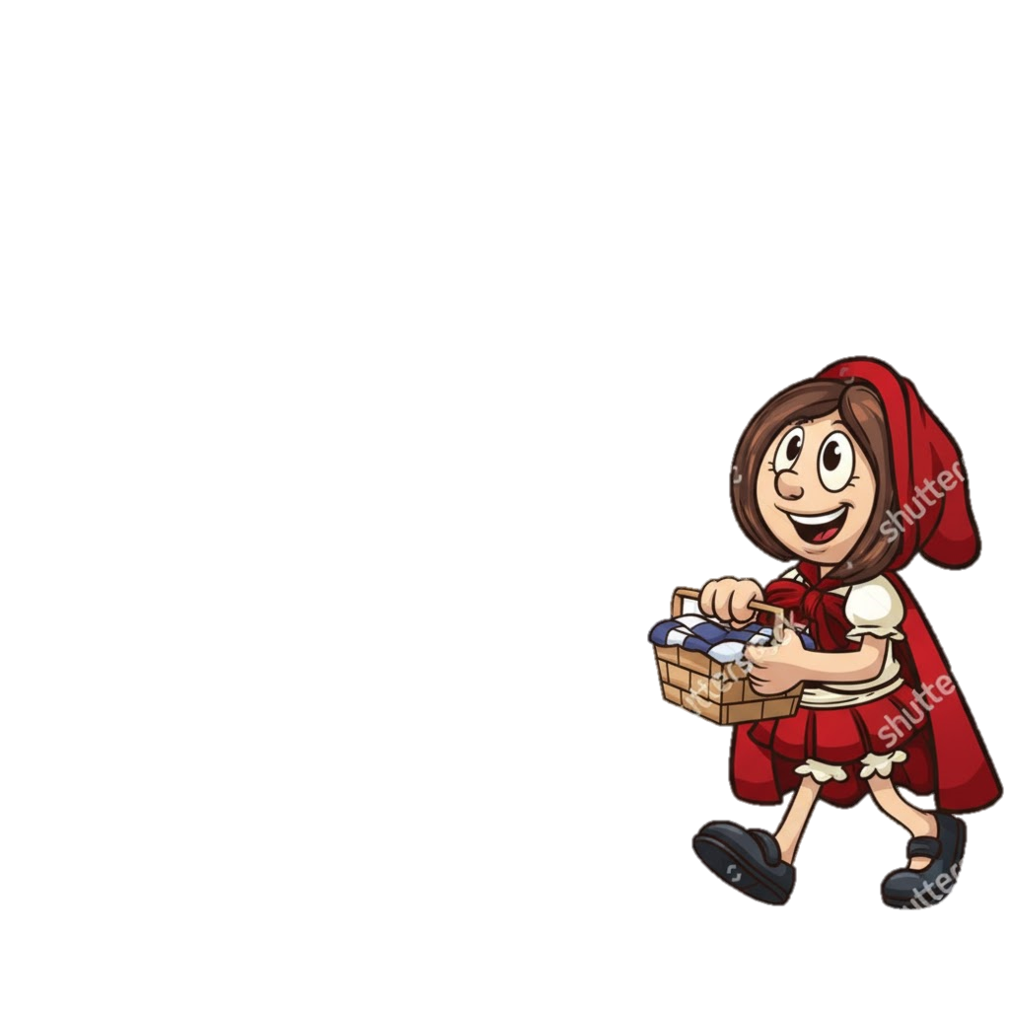
Once upon a time there was a little girl named
Red Riding Hood.

Slide 5
Her mother asked her to take food to her sick grandmother.

Slide 6
Don’t talk to strangers Red.

Slide 7
Don’t talk to strangers Red.
I won’t mom!

Slide 8

While walking through the forest, she encountered the BIG BAD WOLF.

Slide 9
I must get to grandma's house first.
I’ll have so much fun at grandmas.

Slide 10


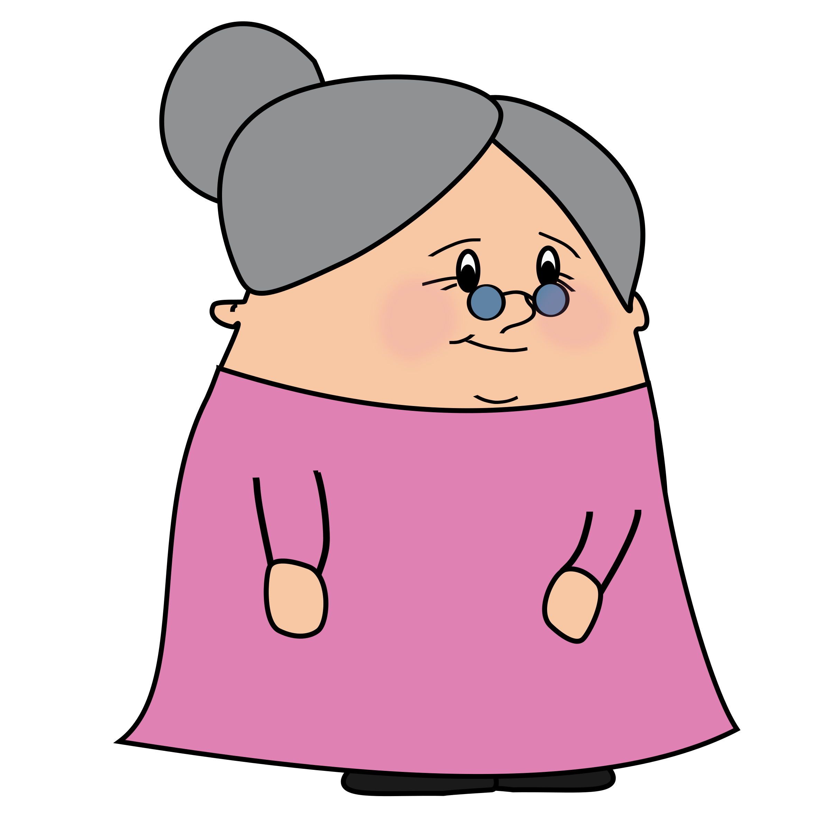
You’re not going to see red…
Why isn’t red here yet?
This Photo by Unknown Author is licensed under CC BY-NC

Slide 11
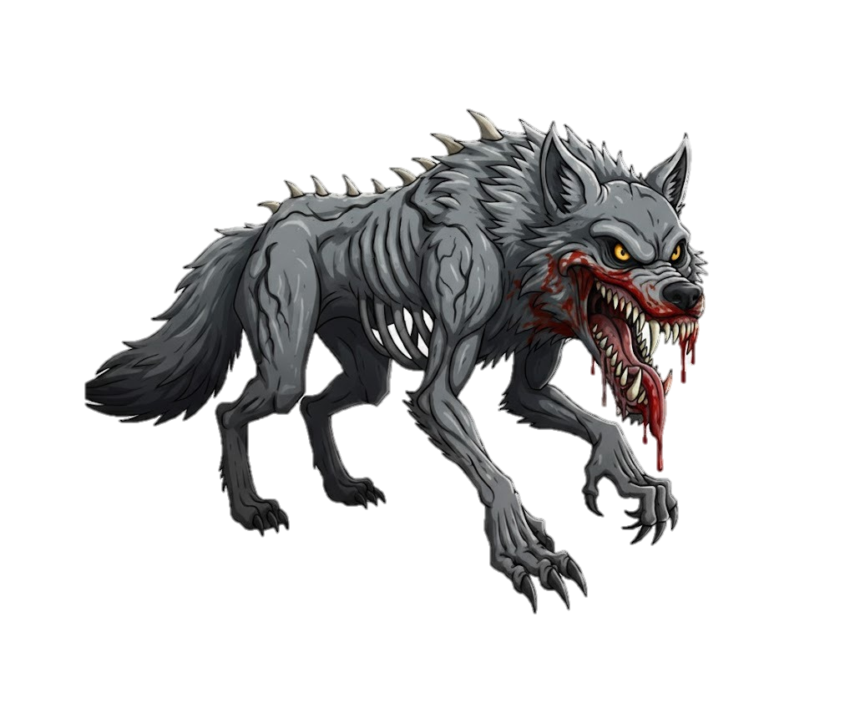
Now that little girl is next.
This Photo by Unknown Author is licensed under CC BY-NC

Slide 12
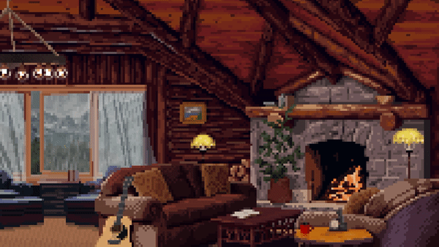
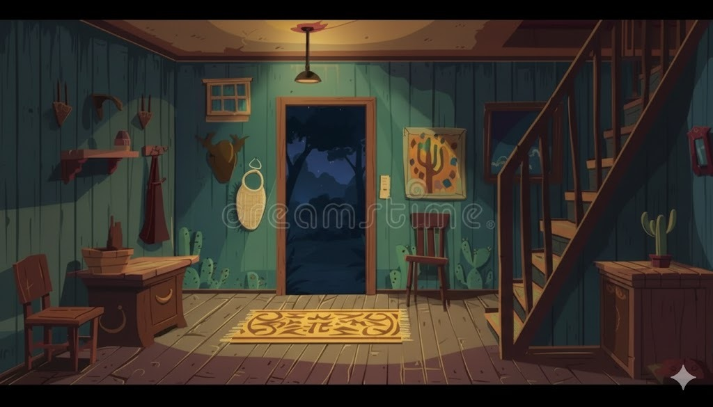
Where’s Grandma?

Slide 13
You’re next little girl….

Slide 14
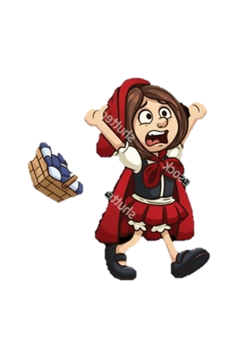
HELP!!
This Photo by Unknown Author is licensed under CC BY-NC

Slide 15
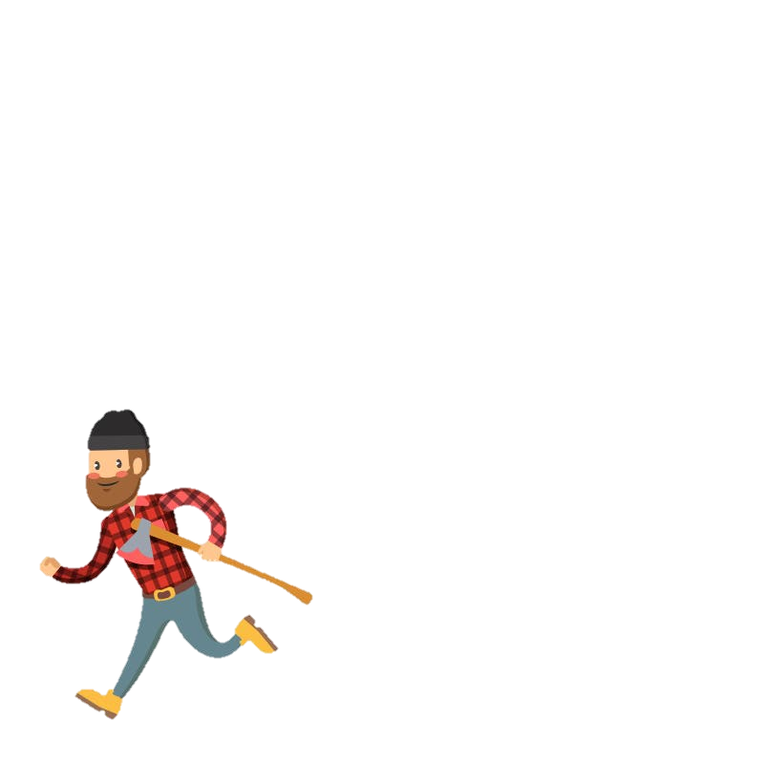
I’M HERE!!
This Photo by Unknown Author is licensed under CC BY-NC

Slide 16
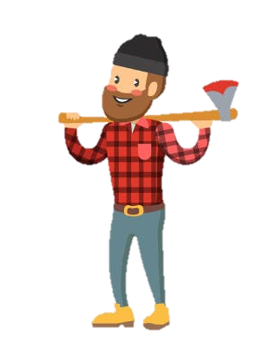
Thank you for saving her.
You’re safe now.
This Photo by Unknown Author is licensed under CC BY-NC

Slide 17
The End

